Slide 1
Programming
Merit Badge PowerPoint
© 2018 - 2020 Robert Baker

Slide 2


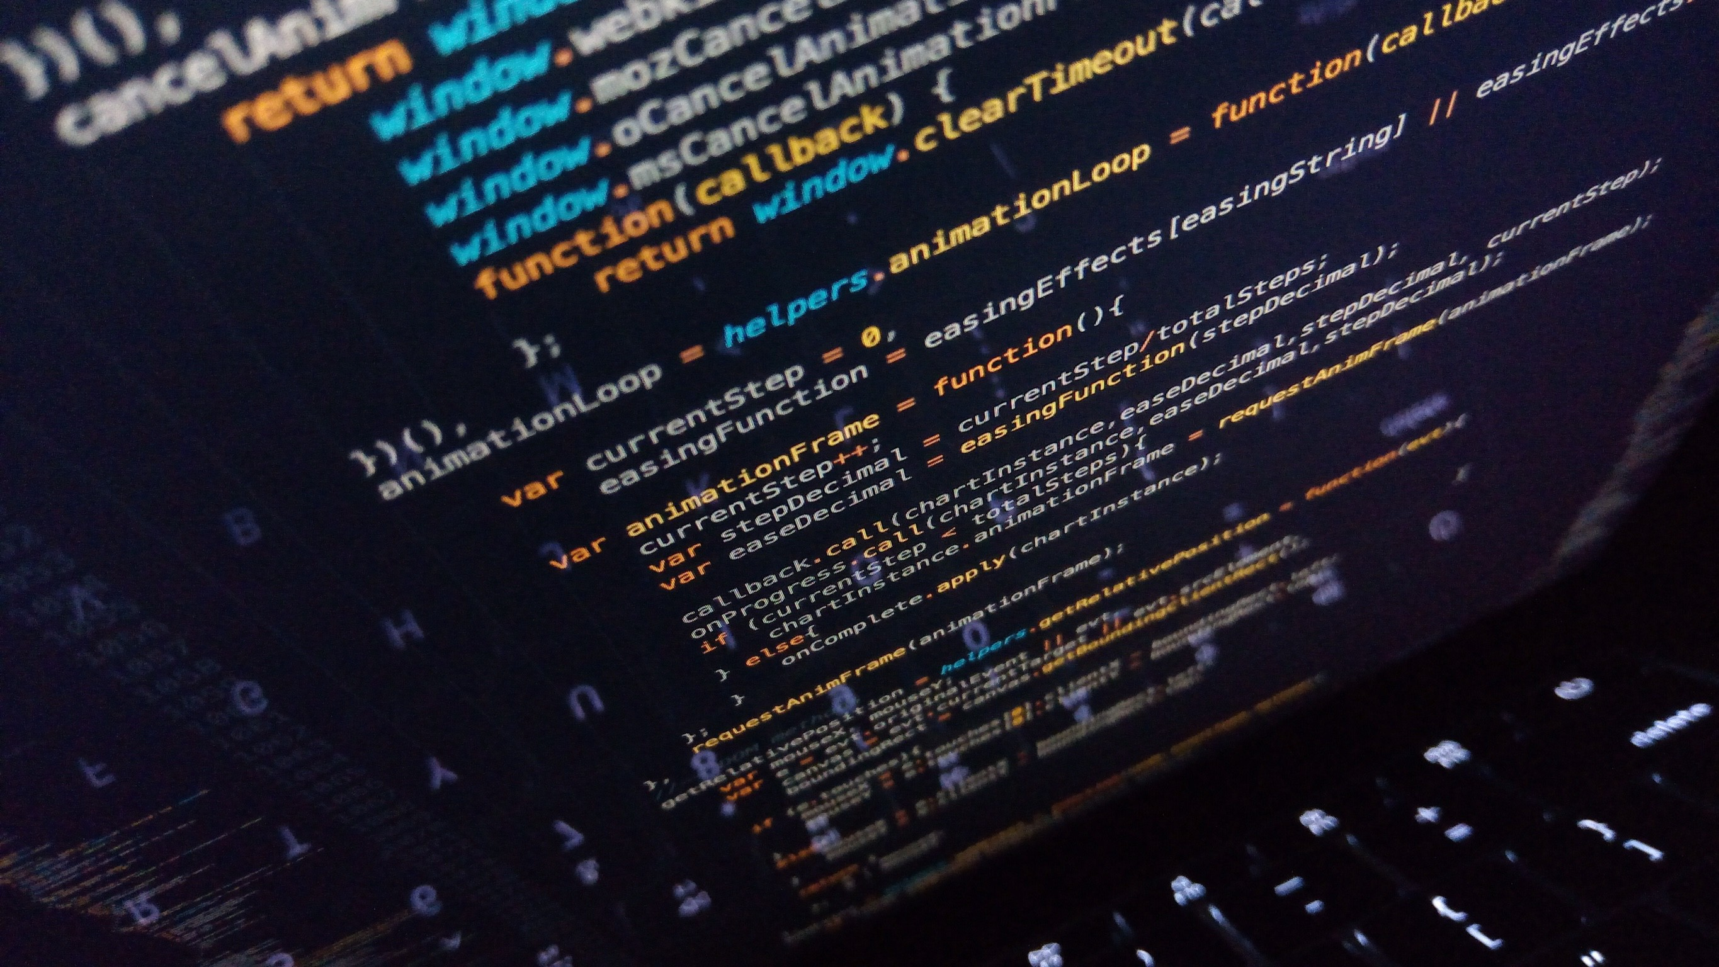
What is Programming

Slide 3
What is programming?
Programming is the act of inserting instructions into a computer or machine to be followed.
There are many different career fields involving the programming of computers; each utilizing different languages, techniques, and systems.
We are only going to cover a few of the different aspects of programming during this Merit Badge, but there are so many more.

Slide 4
Safety
Normally programming normally involves computers, which use electricity. It is important to make sure all power-cords are not frayed, and to keep liquids far away to prevent electric shock.
RSI – Repetitive Stress Injury
Caused by typing for long periods of time and can cause pain in the wrists and hands
How can RSI be prevented?
Eye Strain can be caused by using computer screens for extended periods of time.
How can eye strain be prevented?
Notes:
RSI Prevention
Proper keyboard height & position
Ergonomic keyboards
Quality chairs

Slide 5
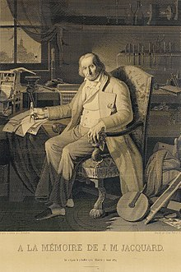
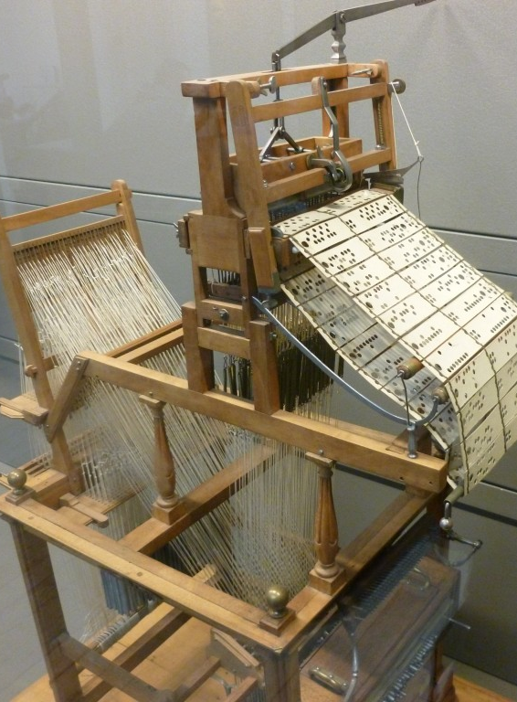
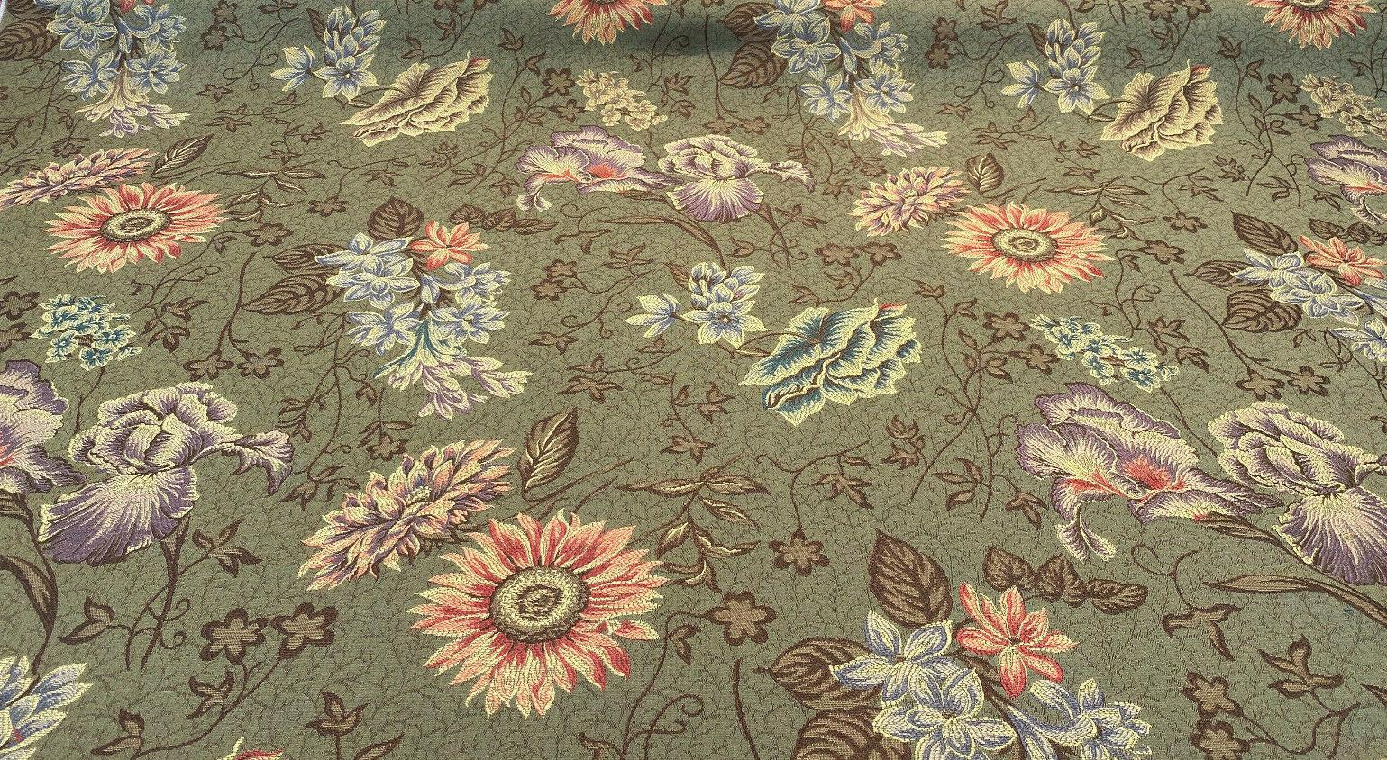
Before Computers
Before the modern electrical computer, mechanical devices used in factories were the first machines to be programmed.
An example is the Joseph Jacquard Loom (1804) which used hole-punched cards to “program” patterns into fabric.
The picture on the right is the loom.
The picture on the left is a portrait of Jacquard was woven in silk on a Jacquard loom and required 24,000 punched cards to create (1839). One of these portraits in the possession of Charles Babbage inspired him in using perforated cards in his Difference Engine.

Slide 6
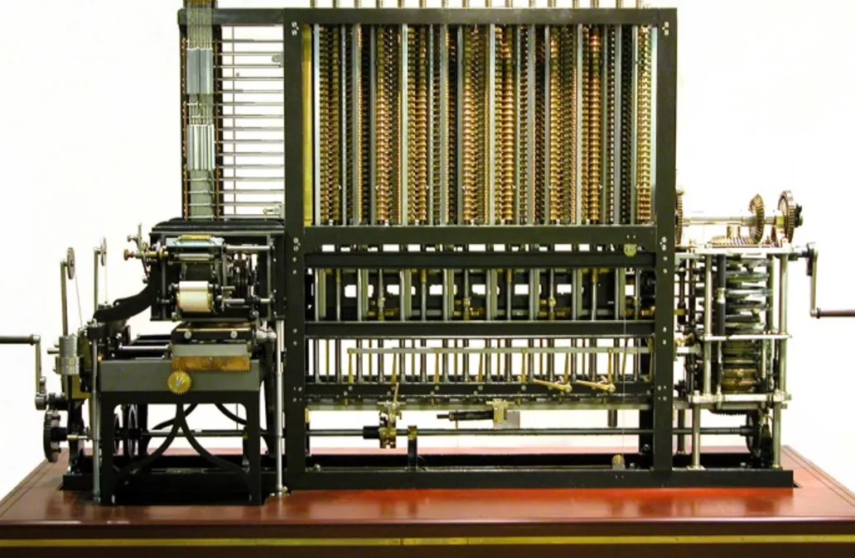
Before Computers
Charles Babbage in 1823 started work on his Difference Engine. It was programmed using punch cards and could do simple calculations to 31 digits. Do to high costs, it was not built until 1991, well after his death. It weighed 15 tons and was 8 ft tall.
It used human-power to turn the gears and cranks and output the result using wheels with digits painted on.
Fun Fact: The gear technology didn’t exist to build his machine, so Babbage invented new ways of cutting gears. This incidentally advanced machinery and factories during the end industrial revolution (1760-1840).
Ada Lovelace, the first programmer, theorized how to program Babbage's Machines.

Slide 7
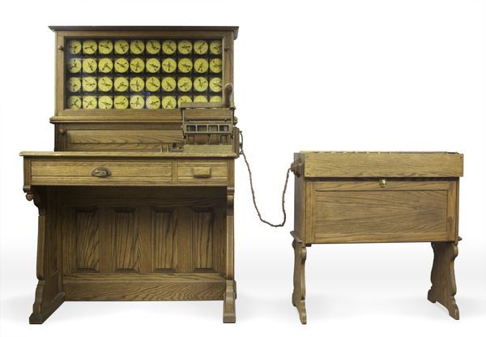
Before Computers
In 1885, Herman Hollerith designed the “Electric Tabulating System”, a machine designed to take on the 1890’s Census. It was an early Scantron-like machine using punch cards.
The 1880’s Census took 7 years to count, so due to the growing population, the 1890’s and 1900’s Censuses would have taken more than 10 years. This would not be good.
With his machine, the 1890’s Census only took 6 weeks rather than 10 years. This proved computers were a viable solution to many previously impossible problems.

Slide 8
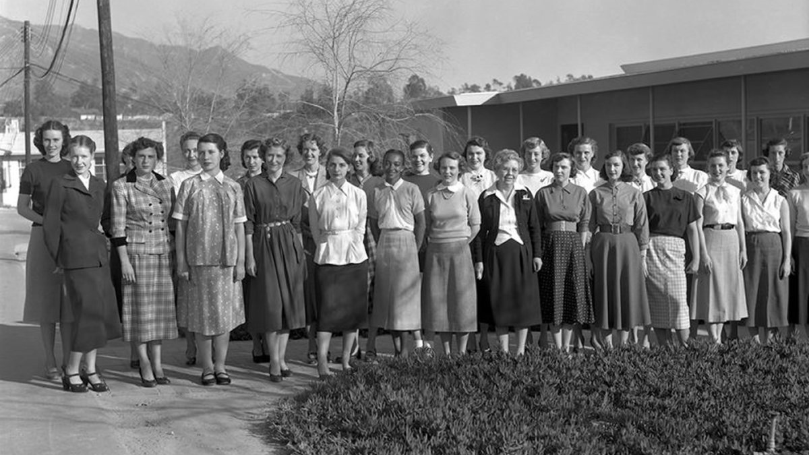
First Computers
What did the first computers look like?

Slide 9
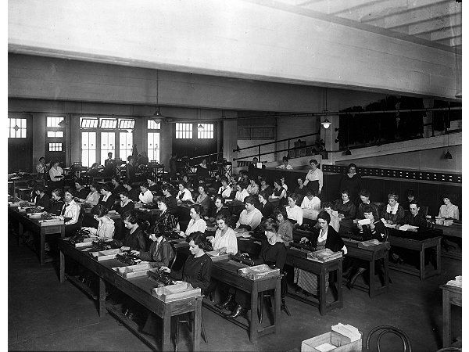
First Computers
A “Computer” used to be a job description, not an electronic machine
Women almost exclusively filled these positions.
Large agencies would have “Computer Rooms” with many ladies doing calculations by hand
A “kilogirl” was a unit of measurement equaling 1000 hours of computing labor

Slide 10
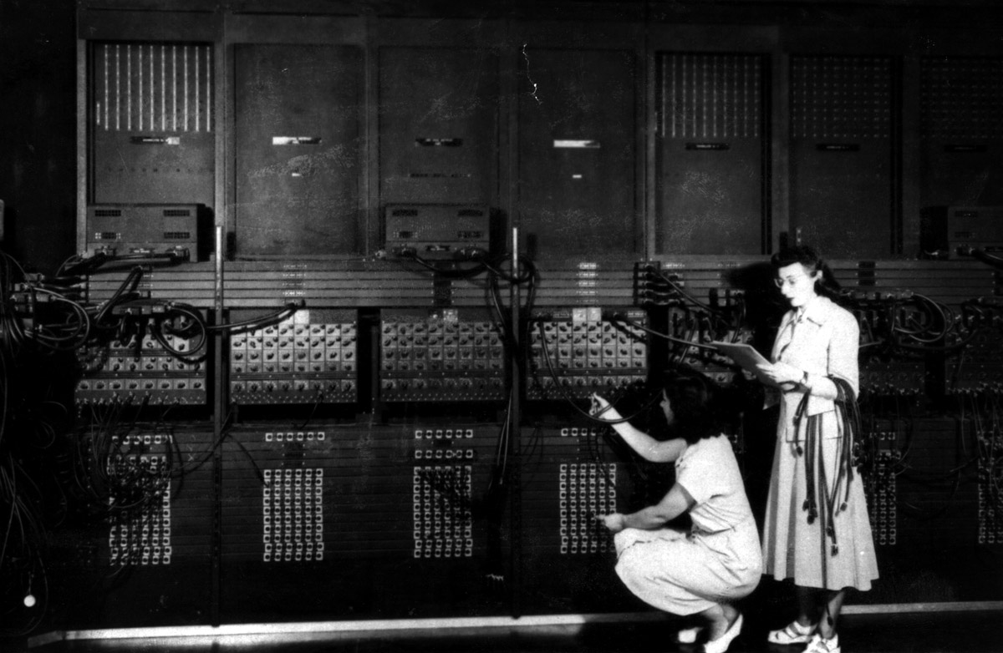
Early Computers
ENIAC – Electronic Numerical Integrator And Computer (1946)
First general-purpose computer
Used Base-10 instead of Binary (Base-2)
They used Vacuum Tubes and Mechanical Switches
Used to calculate firing-tables for the military.
UNIVAC – UNIVersal Automatic Computer (1951)
First commercial computer
Brought computers into the public eye after it correctly predicted the “total-upset, landslide”, 1952 Presidential Election.
ENIAC 1946 – What do you notice about this photo
Notes:
Women, not men, were the ones running these early computers.
This led to many women leading computer science into the 21st century, i.e. Grace Hopper, who programed the ENIAC. She also designed COBOL. This language is still used today.

Slide 11
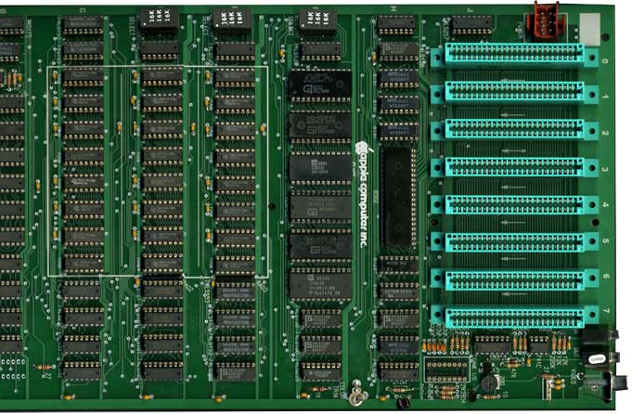
Pre-Modern Computers
After Vacuum Tube and Mechanical Switched computers, Integrated Circuits (ICs) allowed computers to get much smaller. Computers when from the Size of buildings to the size of desks.
This also allowed more powerful computers to be built because less space was needed.
This is an Apple2 motherboard.
All the black chips make the CPU.
Each one is about 1” wide.

Slide 12
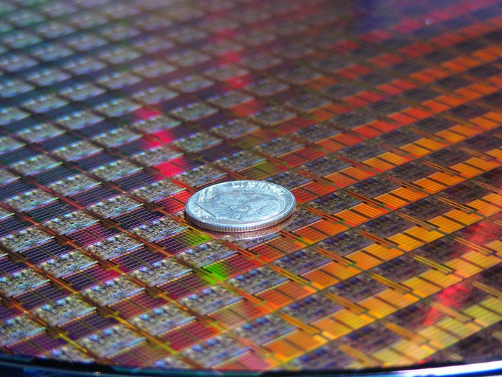
Modern Computers
The Microprocessor allowed computers to go from the size of desks to the size of a dime!
Each small square in this picture is a computer!
This allowed use to make computers even more powerful and allow us to use even more powerful language features.
Each “switch” in these chips are 10nm wide

Slide 13
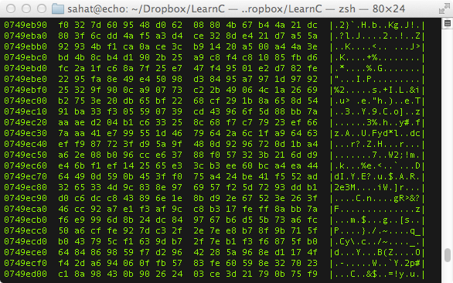
History of Programming
What was the first programming language?
Binary / Machine Language (ML)
Binary / ML is really hard to read, but it can be done.
Early computers used switches and cables to accomplish this.
It is insanely fast, only limited by hardware speed.
All programming languages end up as Binary / ML at some point during execution.
Notes:
Notice that is Binary / ML is actually represented in Hex, which is just a more compact way for writing Binary.
The column of 8 numbers on the left is the hardware memory address in RAM where each line of code is stored.
The next two big columns are the actual code separated into bytes (each 2 characters is 1 byte).
The third column is the ASCII representation of the data in the previous two big columns.

Slide 14
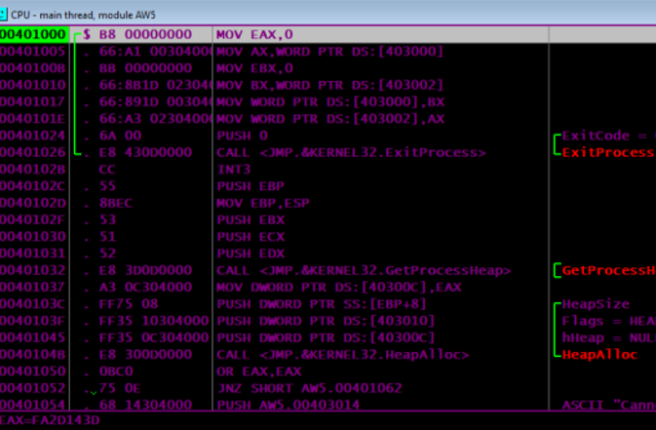
History of Programming
Next came Assembly Language (ASM)
Slightly easier to read than Binary / ML
Still very fast because it maps back to Binary / ML
Very few people ‘need’ to program is ASM
There is a different Assembly Language for each CPU design, so it is not portable code.
Why is portable code good?
Notes:
This is a program I wrote for my Assembly class.
In this photo you can see the hardware memory address in the left-most column.
In the widest column is a x86-Assembly code (MOV EAX,0)
The second column from the left is the Machine Language generated from the x86-Assembly code.

Slide 15
History of Programming
Next-Generation Languages came around the 1950’s.
They allowed:
Code portability between different systems
Easier to write, read and debug code
Allowed for new concepts (i.e. functions, classes, objects, OOP)
Explored new fields (i.e. science, math, computer science, data science, business)
The first big languages were… (in order of creation)
FORTRAN, LISP, COBOL, BASIC and Pascal
Notes:
A lot of old code that was written in FORTRAN or COBOL is still in use today because it would be too expensive to rewrite it.
Also there are huge sections of code that is “dead-code”. People don’t know what it does, so they don’t touch it and it just sits there.

Slide 16
Programming Now
How many languages do you recognize?
C
C++
Java
JavaScript
HTML
CSS
Python
Ruby
PHP
OpenCL
SQL
MATLAB
Erlang
Ada
Objective-C
Swift
Mathematica
C#
Visual Basic
Rust
F#
R
Go
PowerShell
BASH
TypeScript
PostScript
CoffeeScript
Perl
x86-Assembly MASM
RegEx
PL/SQL
MIPS
ColdFusion
LaTeX
XML
JSON
Ladder Logic
YAML
Batch

Slide 17
C
C++
Java
JavaScript
HTML
CSS
Python
Ruby
PHP
OpenCL
SQL
MATLAB
Erlang
Ada
Objective-C
Swift
Mathematica
C#
Visual Basic
Rust
F#
R
Go
PowerShell
BASH
TypeScript
PostScript
CoffeeScript
Perl
x86-Assembly MASM
RegEx
PL/SQL
MIPS
ColdFusion
LaTeX
XML
JSON
Ladder Logic
YAML
Batch
The Green Languages are General Programing Languages
The Purple Languages are Scripting Languages
The Red Languages are Markup Languages
The Blue Languages are Declarative Languages
The Orange Languages are Assembly Languages
Different types of languages have different purposes.
It is important to match the type of work to the correct language to insure the best results.

Slide 18
Programming Languages
Here are a few languages and the problems they try to tackle…
Python – High-level, general-purpose | Emphasizes code readability. Dynamically typed and garbage-collected.
C++ – General Purpose, High Performance | ex. Game Engines, Desktop Apps (Adobe Photoshop, Chrome)
C – General Purpose, High Performance, Light Weight | ex. Linux OS, macOS, Integrated Circuits, Drivers
Java – General Purpose, Multiplatform | ex. Minecraft, Server Apps, Android Apps
C# – General Purpose, Windows Platform | ex. Unity Games, Server Apps, StackOverflow
Swift – General Purpose, iOS & macOS | ex. most apps for iPhones and macOS (replaced Objective-C)
SQL – Database Communication
JavaScript – General Web Scripting | ex. Interactive webpages, webpages that can run dynamic code
HTML – Webpage Design, Layout and Markup
CSS – Webpage Styling, Coloring, Fonts and Positioning
PHP – Web Server Code | ex. Backend Web Dev., Web Content Management Systems (i.e. WordPress)
TypeScript – Stricter Superset of JS that transpiles into JS |ex. Large JavaScript Apps
XML – Human and Machine readable file format for data sharing between apps

Slide 19
Programming Examples
Hello World
C++
#include <iostream> int main(int argc, char *argv[])
{
char myString[] = “Hello World!”;
std::cout << myString << std::endl;
return 0;
}
Java
class HelloWorld {
private String myString = "Hello World!";
public static void main(String args[]) {
System.out.println(myString);
}
}
Notice how different languages can look very different even when they are doing the same task.
Notice also how the bracing ( i.e. “{}”) style is different between languages.
Notes:
The reason for the different colors here is due to syntax highlighting.
Syntax Highlighting is a feature in programming apps where it automatically colors different parts of the code to increase readability.

Slide 20
Programming Examples
Hello World
JavaScript
myString = "Hello World!";
console.log(myString);
Python
myString = 'Hello World!'
print(myString)
Notice how different languages can look very different even when they are doing the same task.
Notes:
The reason for the different colors here is due to syntax highlighting.
Syntax Highlighting is a feature in programming apps where it automatically colors different parts of the code to increase readability.

Slide 21
Programming Examples
Hello World
C#
using System;
using System.Collections.Generic;
using System.Text;
namespace ConsoleApplication1
{
class HelloWorld
{
String myString = "Hello, world!";
static void Main(string[] args)
{
Console.WriteLine(myString);
}
}
}
X86 Assembly
.486
.model flat, stdcall
.stack 100h
option casemap :none
ExitProcess PROTO Near32 stdcall, dwExitCode:dword
putch PROTO Near32 stdcall, bChar:byte; .data
strMyString byte "Hello World",0
.code
main PROC
mov ecx, LENGTHOF strMyString
mov esi, OFFSET strMyString
L1:
invoke putch, byte PTR esi
inc esi
loop L1
invoke ExitProcess,0
main ENDP
END main
Notes:
The reason for the different colors here is due to syntax highlighting.
Syntax Highlighting is a feature in programming apps where it automatically colors different parts of the code to increase readability.

Slide 22
Programming Language Types
Languages can be split into a three different levels..
High-Level (ex. Python, Ruby, JavaScript, Java, SQL)
C-Level (ex. C, C++, Rust)
Low-Level (x86 Assembly, Machine Language)

Slide 23
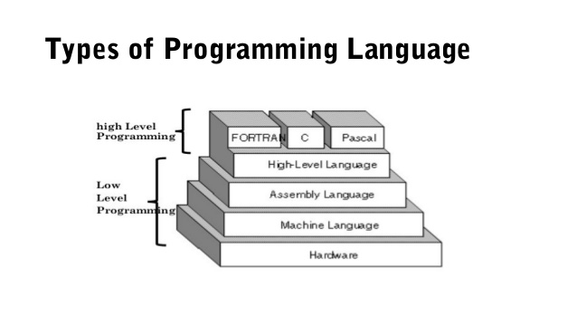
Programming Language Types
Why would you use a High-Level, Low-Level or C-Level language?
Low Level
Pros: Fast Execution, No Overhead, Single Platform, Compiled
Cons: Hard to read, write, debug, and maintain
Examples: ML, MASM, TASM, NASM, MIPS
High-Level
Pros: Easier to read, write, debug, and maintain, Multi-Platform, Compiled or Interpreted
Cons: Slower than Low-Level, not as much control over hardware
Examples: Python, Ladder-Logic, JavaScript, Java, SQL
C-Level
Best of both worlds, Compiled
Good control over hardware with ease of writing.
Examples: C, C++, Rust, FORTRAN, PASCAL
Note: Java, Python, etc. are one level higher than FORTAN, C and PASCAL

Slide 24
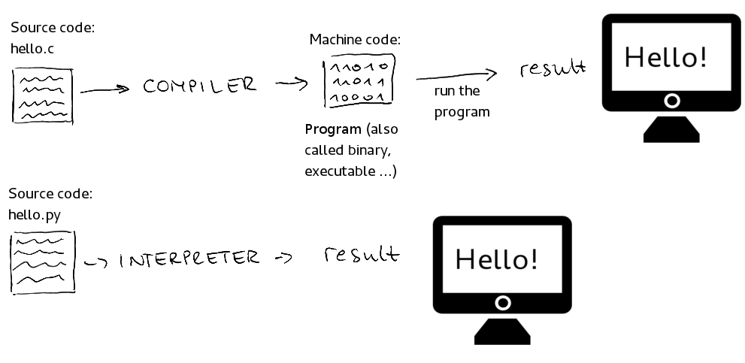
Programming Language Types
This photo illiterates the difference between compiled and interpreted languages…
Make a list of 3 compiled languages and 3 interpreted languages.
Where would you use a compiled languages vs an interpreted language?
Done every time
Done once
Done every time

Slide 25
Programmed Devices
Our lives are filled with so many programmed devices, you many not even notice…
What are somethings around your house that are programmed?
Smart TVs, Smart Door Bells
Xbox, PlayStation, Wii, Ms. Pacman
Microwave, Dishwashers, Wi-Fi Router
Smart Watch
Etc..
What language do you think these were programmed in?

Slide 26
intellectual property (IP)
Copyright – protects a particular expression of an idea that the author created (i.e. PowerPoints, Game Art, Specific Code)
Patent – protects useful innovative processes or methods, machines, manufactured items, or “compositions of matter” (i.e. a new and revolutionary math algorithm used in an app)
Trademark – protects a word, phrase, symbol or sound that identifies and distinguishes the source of a particular product or service (i.e. Windows Logo, “Your mattress is freeee”, etc.)
Trade Secret – protects valuable information be not disclosing it to anyone, enforced by a contract called a NDA (i.e. what info Facebook collects)

Slide 27
Owning vs Licensing
Do I own a copy of PowerPoint?
Do I own a copy of Google Chrome?
Do I own a copy of an App I built?
What is the difference between owning and licensing?
Owning means you can do what ever you want to the software. Most people do not own software.
Licensing is where you “buy or get permission” to use the software, often subscription based.

Slide 28
License Types Explained
Open-Source – the code is exposed to the public and can be modified or distributed, may be limits or restrictions (doesn’t mean free).
Closed-Source – the code is NOT exposed to the public and cannot be edited or distributed (doesn’t mean free).
Freeware – 100% free to use, not necessarily free to be modified or distributed.
Shareware – free to download and use, but asked for donations (i.e. Ad-Block). Not free to modify or distribute.
Demo – A free trial version of the program, may not have all the features enabled. Not free to modify or distribute.
Pubic Domain – There is absolutely no ownership such as copyright, trademark, or patent. Software in the public domain can be modified, distributed, or sold even without any attribution by anyone.

Slide 29
Careers in Programming
What are some careers you have heard of in a programming field?
Computer Scientist
Mobile App Developer (dev)
Desktop App Dev
UI / UX Engineer
Software Engineer
Game Engine Dev
Gameplay Dev
Database Engineer
Hardware Engineer
Computer Engineer
Sysadmin
Hacker / Pen-Tester
Web Dev (frontend and backend)

